Slide 1

Credit Card
Fraud Transactions
Team 6 – ELITE 1337
​
Ismail Ellahi, Nehal Ghauri, Muhaymin Raza, Elee Saleem, Xhulio Zhapa

Slide 2





Motivation
Credit card fraud is a major problem and results in billions of dollars lost
Along with the cost to financial system, there is a cost associated with detecting the fraud
Many non-fraudulent transactions are wrongly classified and declined due to this
Information helpful to financial institutions and clients

Slide 3

Problem Statement
The question we are attempting to solve is:
How to predict or classify a certain transaction?
Whether is a safe trusted transaction or a fraudulent transaction.

Slide 4

Data Collection
1
Kaggle dataset of credit card transactions for October 2020
Credit Card Fraud Transaction Data
https://www.kaggle.com/datasets/anurag629/credit-card-fraud-transaction-data/
2
It consists 100k records of transactions mostly in the UK
3
Data was recorded in Oct 2020
4
It covers geolocations of transactions

Slide 5
Exploratory Data Analysis (EDA)
1
2
3
4
Collecting data from CSV file and importing it into SQL database.
Importing data from SQL Database to Python.
Nulls removal followed by data conversion to its true form.
Finding out that 7% of records of the dataset are fraudulent transactions.
5
6
7
8
Visualizing relationships within data.
Dropping “Transaction ID” and “date” columns
Splitting “fraud” column (target) from the rest dataset
Encoding categorical variables to numeric forms.

Slide 6



CSV → SQL Database
1- Importing Data stored →
2- Importing Data from →
3- Cleaning and the rest of code

Slide 7

Data Description
Data conversion included:
1
Removing space and “#” in transaction ID column
2
Converting the data into integer
100,000 credit transactions in October, 2020
3
Converting the ‘date” column from object to date
16 unique columns
4
Converting data type in “Amount” column from object to integer
515 Rows Removed with NaN as some columns contained less rows than others
5
Converting data type in “Age” from float to integer

Slide 8

Predicting with Logistical Regression and Random Forest
Does dataset have a “target” variable.
Does dataset have enough amount of data to be studied.
Logistical Regression is the most used for predictions in finance since it’s efficient for large dataset and designed for binary classification tasks.
Random Forest is good for classification and regression since it’s optimal for non-linear relationships for data points therefore it can model complex relationships in the data. less prone to overfitting compared to individual decision trees.

Slide 9

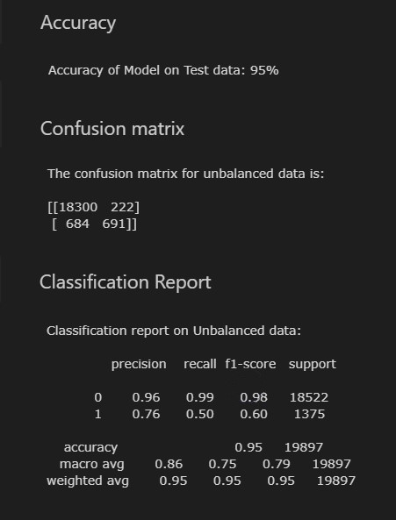
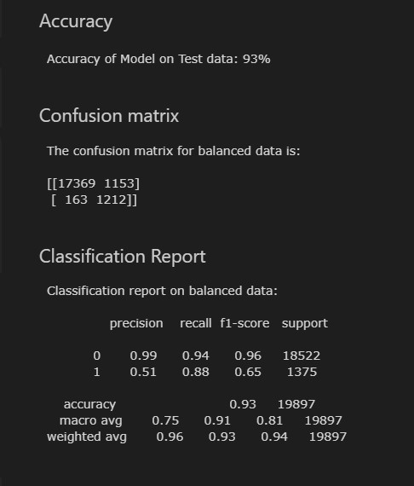
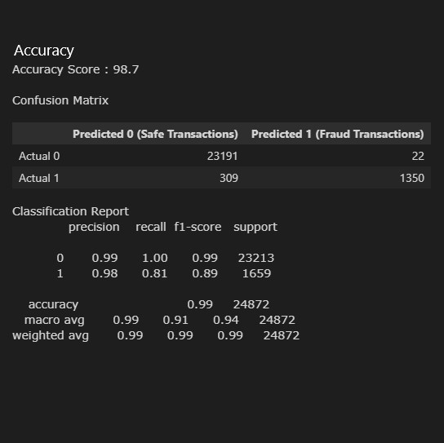
Logistical Regression before balancing target training data
Logistical Regression after balancing target training data
Random Forest

Slide 10
Demo with Tableau
https://github.com/Elee-Saleem/team-6-project-4/blob/main/credit_card_transactions%20xhulio.twbx

Slide 11
CSV data
SQL
Tableau Visualization
Cleaning and Preparing Data
Testing Machine Learning Algorithm
Good Performance
Bad Performance

Slide 12

Summary
Feature Importance
Model Performance: Understanding the nature of the data, addressing imbalances, and selecting the right model are crucial for effective fraud detection.
Feedback Loop
Business Impact:
Increased security and risk detection measures for CVC & online transactions
Residents in certain countries may desire double verification systems

Slide 13

Limitations
1
Data had records over 2 months and was recorded for 2 days
2
Data was more concentrate about British clients.
Data Drift: model's performance degrades
3
4
Data imbalance: Logistic Regression not feasible when data skewed in one direction

Slide 14

Next Steps
1
Data of the whole year needed to be collected and studied
Inclusion of more data from other countries of residences as well
2
3
Study data from other large economies such as all G20 countries for improved comparisons

Slide 15

Reflections
To answer the problem: ​
Users within the age group of 40-49 and users completing transactions through CVC and online are most at risk​
​
Technical Reflections:​
How to import data from SQL Database into python
That oversampling is not always useful
​
​

Slide 16

Appendix
You should add citations to any and all code, research and/ or data links that have been used in your project here. Also, link to your github repo and project timelines and/ or project board should be here.
Dataset: https://www.kaggle.com/datasets/anurag629/credit-card-fraud-transaction-data/
GitHub Repository: https://github.com/Elee-Saleem/team-6-project-4/tree/main Project Timelines Board: https://github.com/users/projects/2/views/View 1 · Team 6 project
Tableau Link: www.
Chat GPT
Stackoverflow

Slide 17
THANK YOU FOR LISTENING!

